Slide 1



Slide 2


SUMMARY

Slide 3


Slide 4
Main Dash. Indicators Evolution
NOMBRE, | LE-Full Year 19 | 2019% | DIC 18 | 2018 % | DIC 17 | 2017% | DIC 16
SALES | 426,709,297.50 | (-/+ Sales) -12% | 480,134,483.34 | (-/+ Sales) +15% | 416,625,814.03 | (-/+ Sales) +1% | 412,028,990.39
Gross Operational MARGIN | 125,566,525.96 | 30% | 149,490,588.30 | 31% | 122,226,919.35 | 29% | 127,738,725.99
OPEX | 87,405,355.32 | 22% | 69,214,573.76 | 13% | 67,572,849.68 | 16% | 62,594,867.74
EBITDA (Avg. Jul-Sept-2019) | 38,161,170.64 | 9% | 80,276,014.54 | 16.7% | 54,654,069.67 | 13% | 65,143,858.25
OWC | 175,576,245.58 | 41% | 182,051,108.87 | 38% | 174,137,683.98 | 42% | 170,516,983.55

Slide 5
MAIN PRODUCTS ($)
NUM. | DESCRIPTION | $Sales 2018 | $Sales 2019
A952 | AZUCAR GRAN. REFINADA “potrero” | 19,195,520 | 24,391,290
L162 | LANOLINA ANHIDRA USP CLARA C | 26,673,194 | 18,483,600
G605 | GRENETINA/COLAGENO HIDRO.CER | 23,700,954 | 15,912,697
A798 | ALCANFOR SINT.DAB USP | 15,889,757 | 13,068,130
G102 | GLICERINA PURA USP (IMPORTAD | 3,182,552 | 9,913,315
C677 | CLORURO SODIO GRAN. API | 1,106,567 | 8,423,698
A675 | ACIDO MALICO | 3,723,209 | 9,573,933
P819 | PROPILENGLICOL PURO USP.AMER | 5,278,133 | 6,286,420
L150 | LACTOSA MONO.USP MALLA 200 H | 6,817,337 | 6,066,231
P660 | PODOFILINA BP | 3,267,720 | 5,644,904

Slide 6
VOLUME MAIN PRODUCTS (KG)
NUM. | DESCRIPCION | 2018 | 2019 Full Year –LE
C675 | CLORURO SODIO GRAN.USP-BP-DA | 1,779,167 | 976,834
A952 | AZUCAR GRAN. REFINADA potrer | 1,084,030 | 1,342,074
S675 | SORBITOL LIQUIDO 70% S/ACUOS | 242,731 | 260,666
T100 | TALCO 353 MISTRON | 158,387 | 92,983
B270 | BICARBONATO SODIO MED.FNEUM | 140,306 | 138,665
C656 | CLORURO POTASIO CRIST. USP i | 117,285 | 95,000
V165 | VASELINA LIQUIDA USP 175 USP | 178,545 | 128,127
L150 | LACTOSA MONO.USP MALLA 200 H | 111,713 | 110,736
K110 | KAOLIN FARMACEUTICO BP | 103,510 | 121,410
G102 | GLICERINA USP (IMPORTADA) | 85,253 | 284,700

Slide 7
RECEIVABLES AUGUST 2019
AUGUST 2019 (MXP) | Not Overdue | Overdue<30 Days | Overdue >= 31 to 60 days | Overdue >= 61 TO 90 days | Overdue >= 91 TO 120 days | Overdue >= 121 TO 150 days | Overdue >= 151 TO 364 days | Overdue> 1 year |  | COMPROBACIÓN
RECEIVABLES (A) MEX.CITY | 30,777,760.41 | 7,083,052.32 | 4,676,736.76 | 2,945,425.40 | 1,033,295.92 | 1,131,315.53 | 1,204,163.32 | 266,400.44 | 49,118,150.10 | 49,118,150.10
RECEIVABLES (F) MEXICO | 21,818,924.02 | 2,464,919.00 | 244,884.37 | 89,925.75 | 3,859.59 | 6,673.77 | 6,000.00 | 289,566.64 | 24,924,753.14 | 24,924,753.14
Total | 52,596,684.43 | 9,547,971.32 | 4,921,621.13 | 3,035,351.15 | 1,037,155.51 | 1,137,989.30 | 1,210,163.32 | 555,967.08 | 74,042,903.24
SALES | 36,251,144.65
RATTIO | 2.04
DAYS RECEIVED | 61.27

Slide 8

PURCHASE

Slide 9
2019
35 Suppliers credit Septiembre 2019
85 Suppliers

Slide 10
2019
50 Suppliers credit
Septiembre 2019
83 Suppliers

Slide 11

BUDGET 2020=> 36 days PAYABLES
(2019=> 23DAYS // 37% +)

Slide 12

Payroll

Slide 13
2018 VS 2019
Salaries &wages | 2019 | 2020
Total L/E | $43,350 | $42,336

Slide 14

DEVELOPMENTS 2019

Slide 15
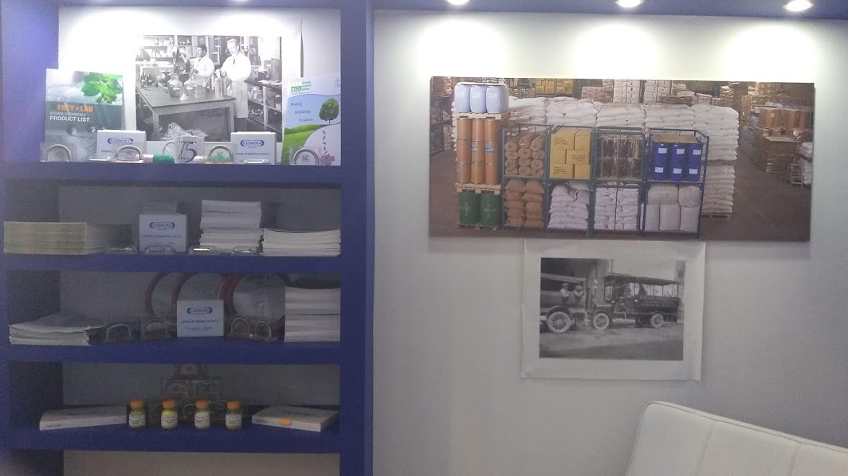
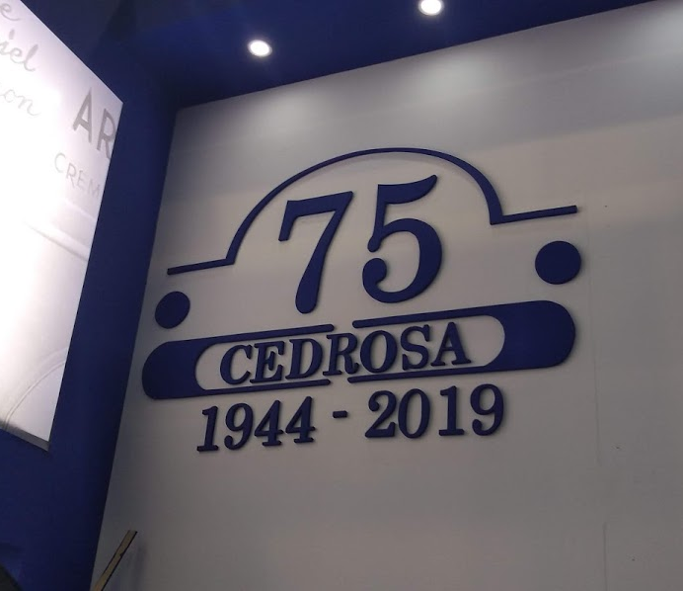
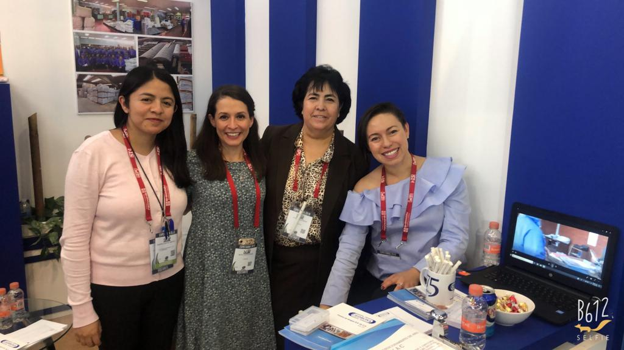
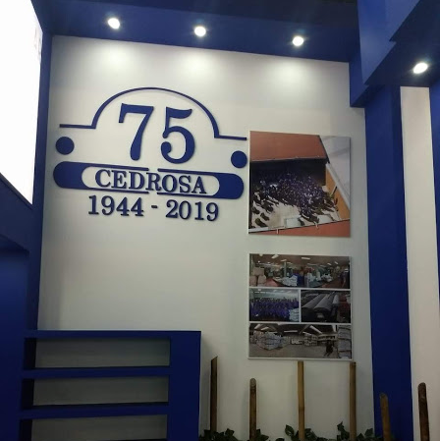
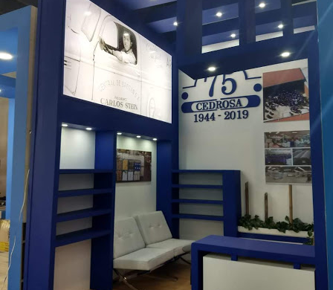
EXPO FARMA 2019
Products promoted:
API´s
Essential Oils
Extracts (Standarized)
TOTAL Visitors EXPO
7,156
TOTAL VISITS STAND
800

Slide 16

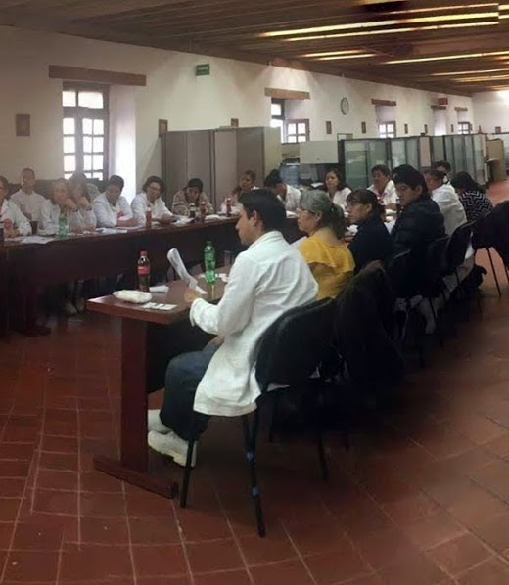
6 Sessions to Farmacia Paris employees Available to clients that request technical assistance or lectures.
ACADEMIES CLIENTS

Slide 17
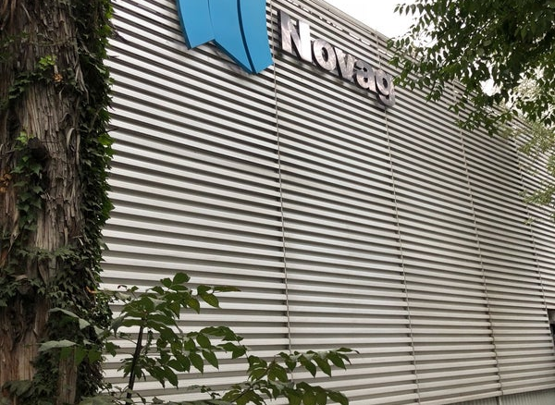
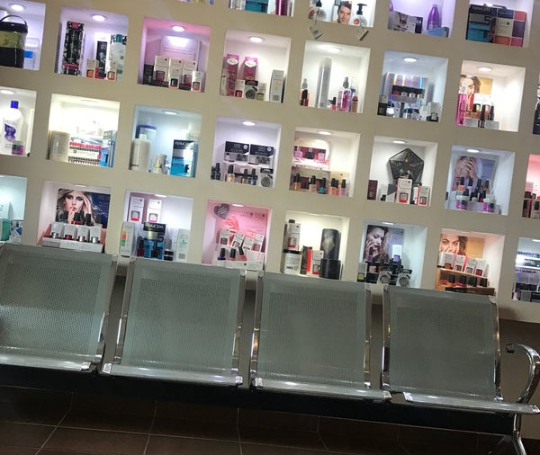


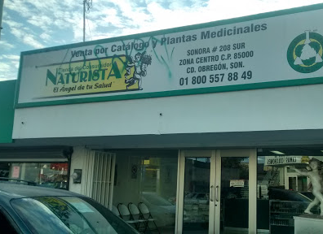
CUSTOMER VISITS
Techical Visits
Product Promotion
Formulation Assistance

Slide 18
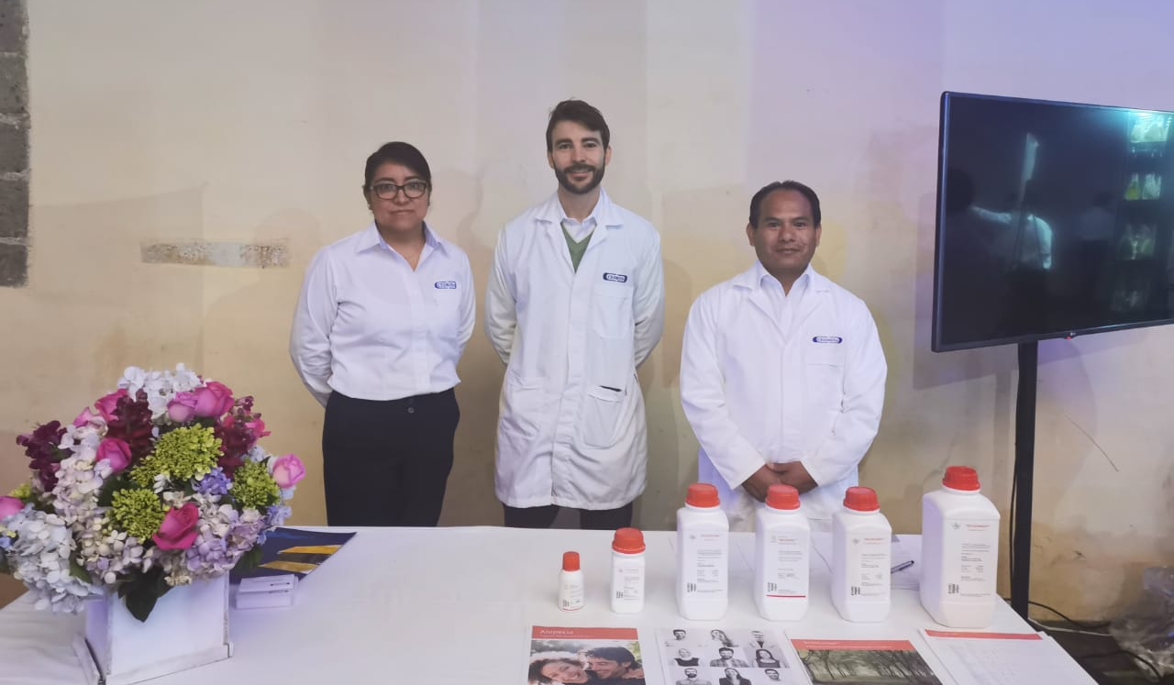
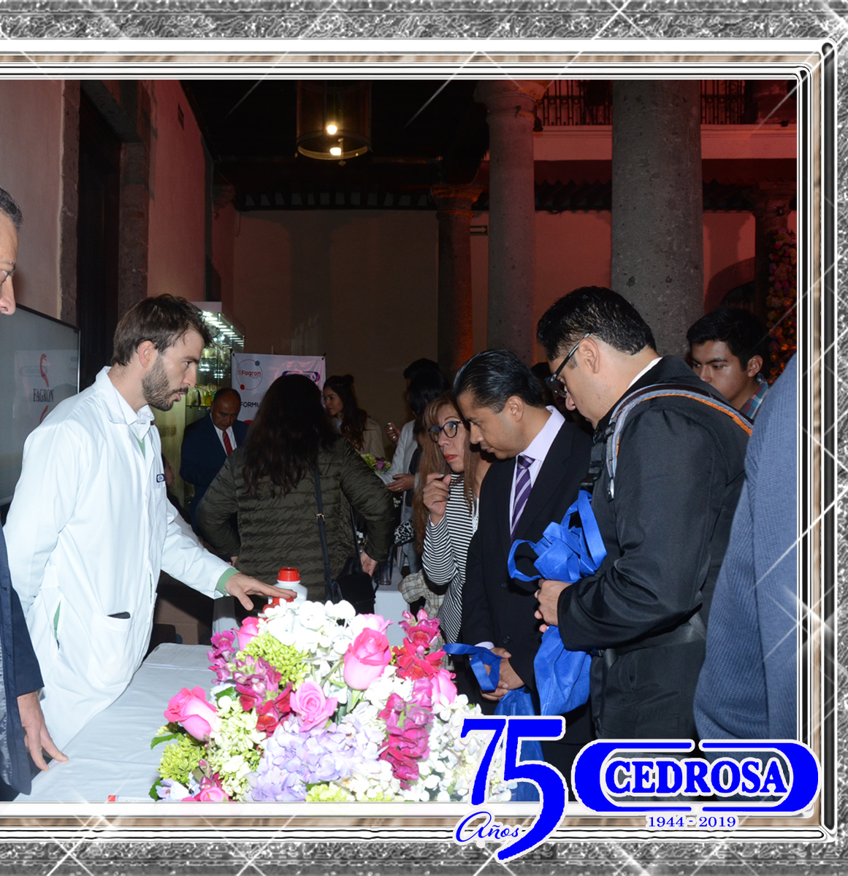
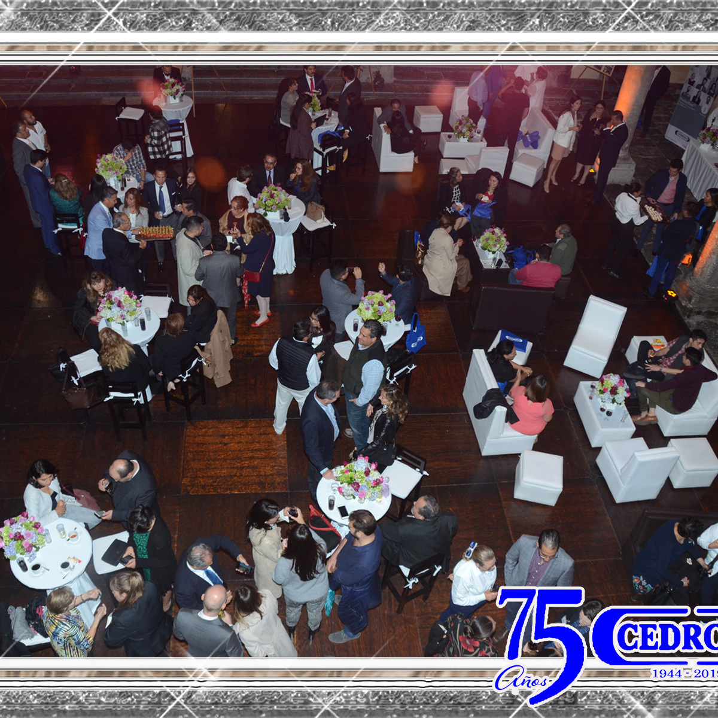
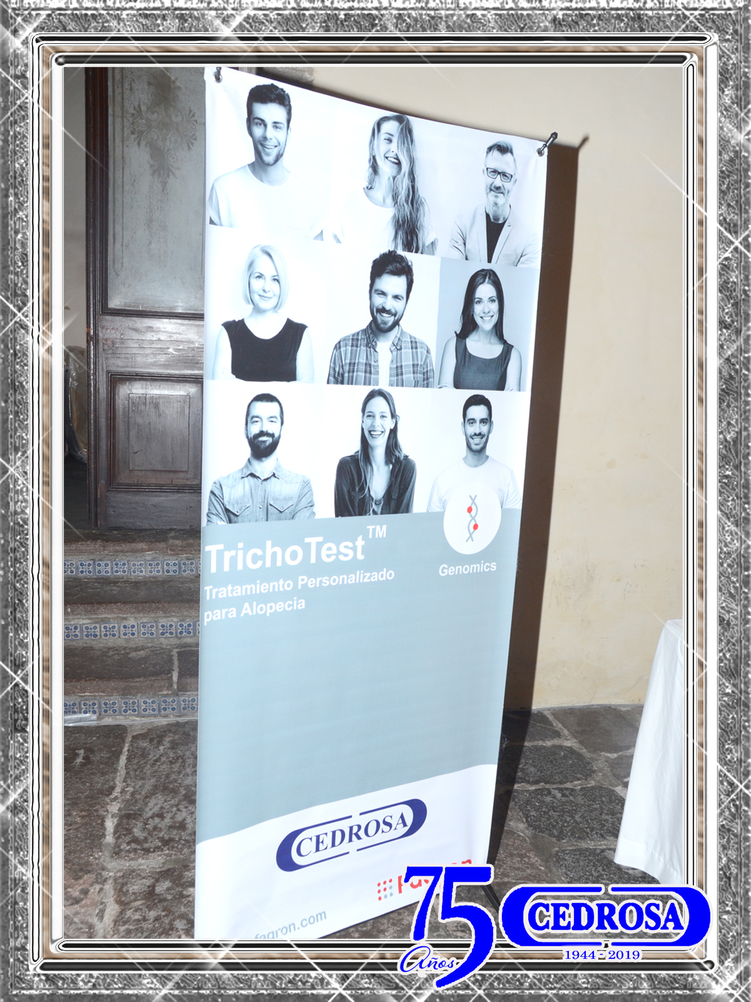
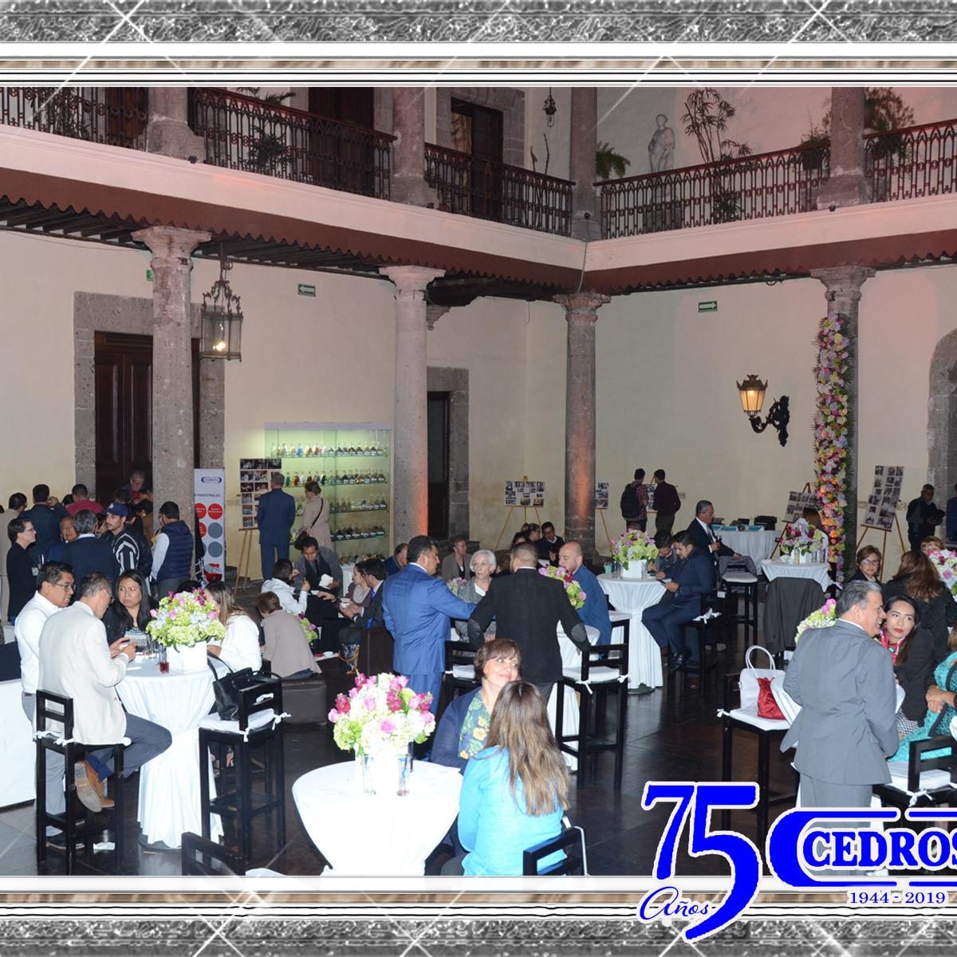
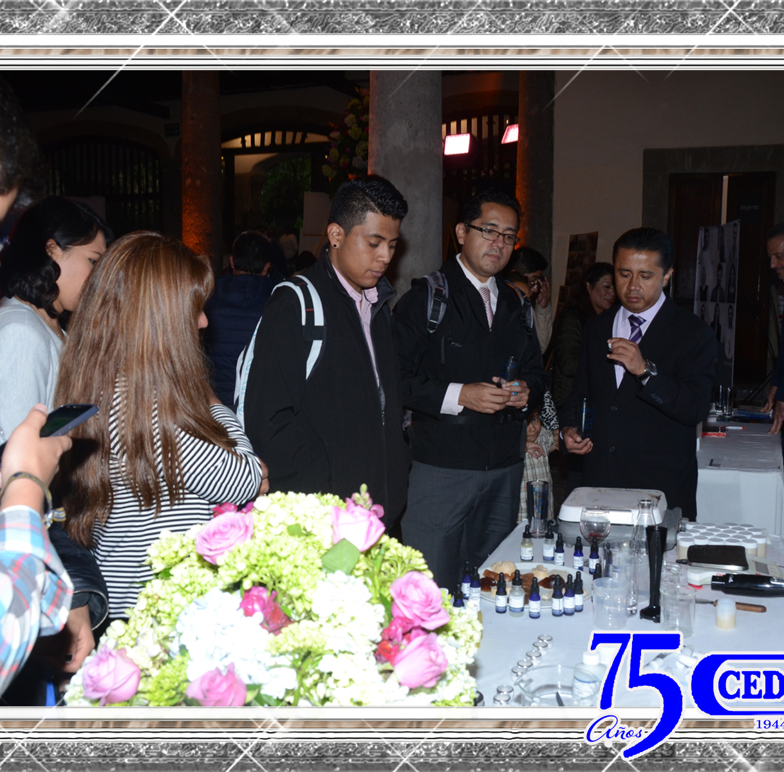
75 YEARS ANIVERSARY

Slide 19
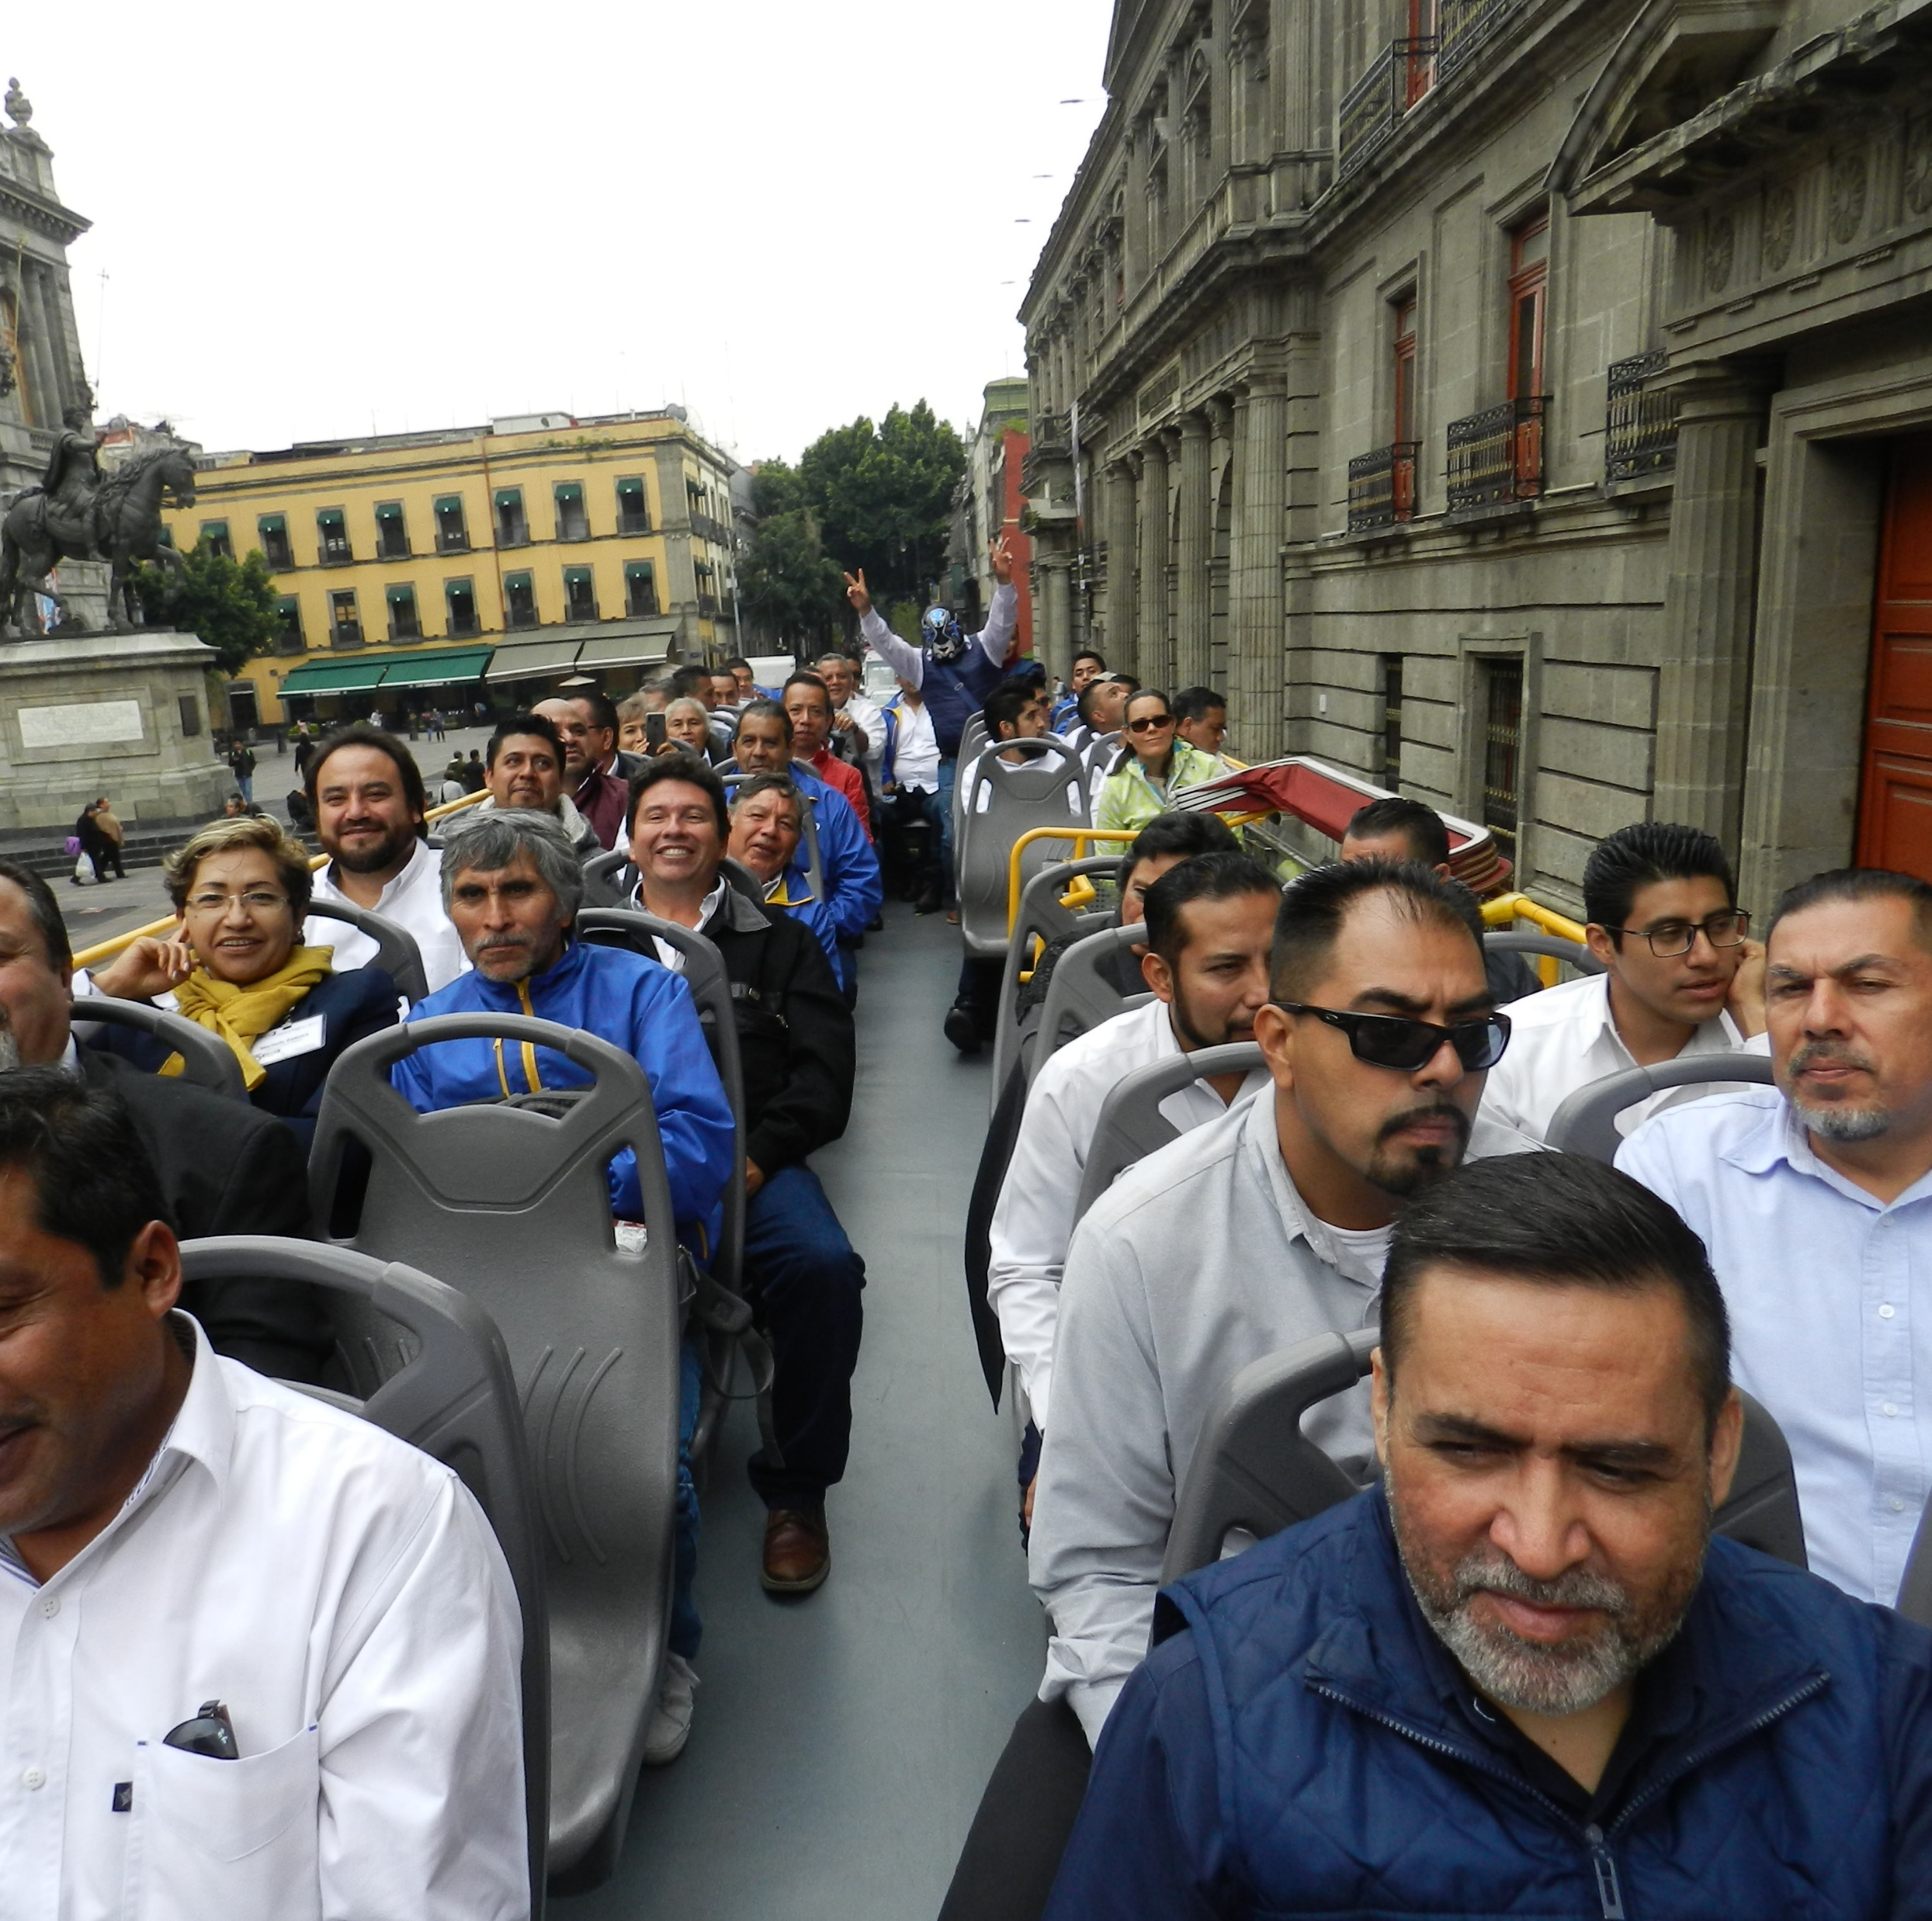
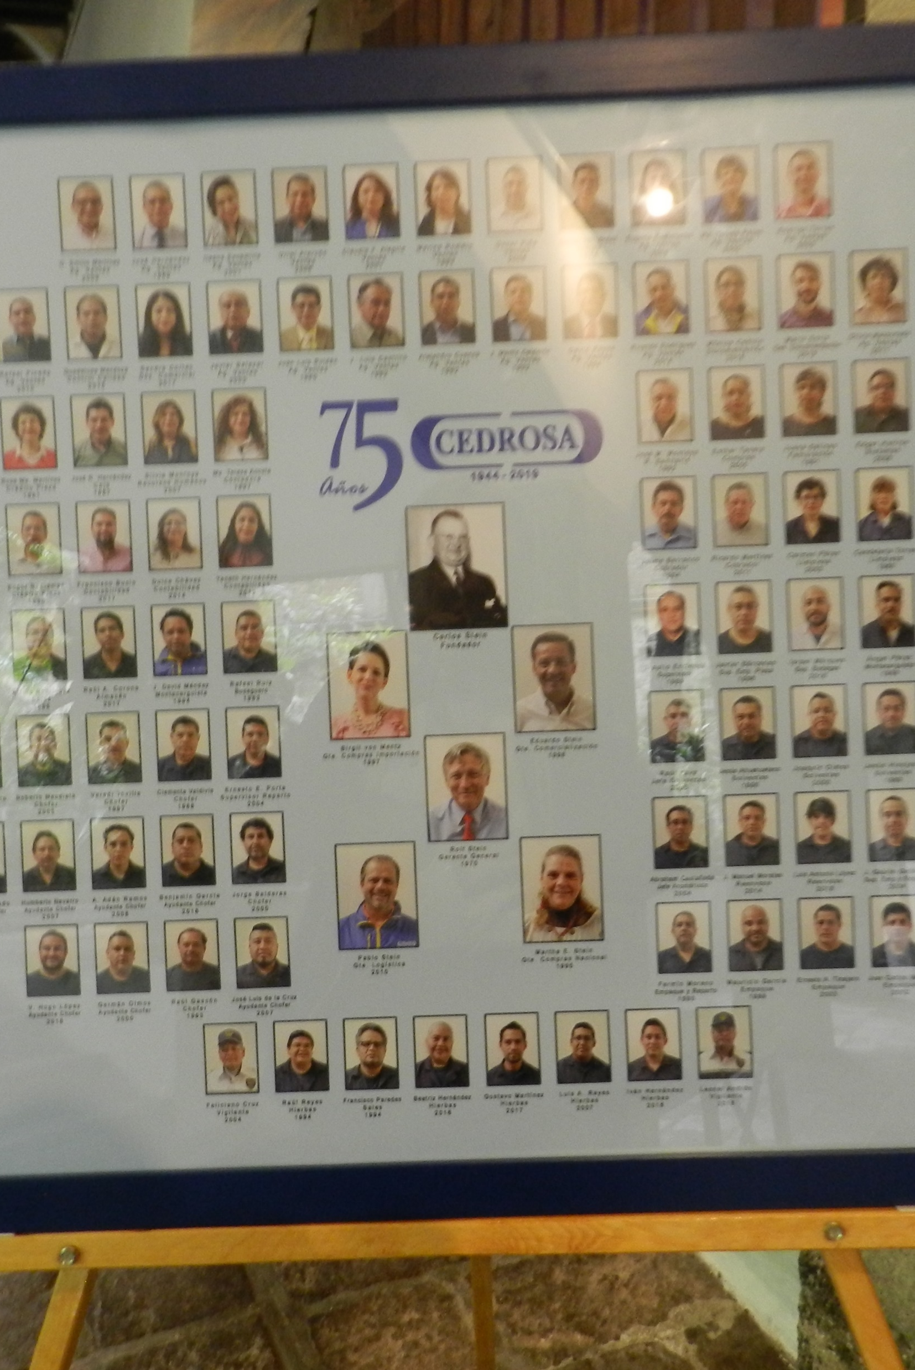
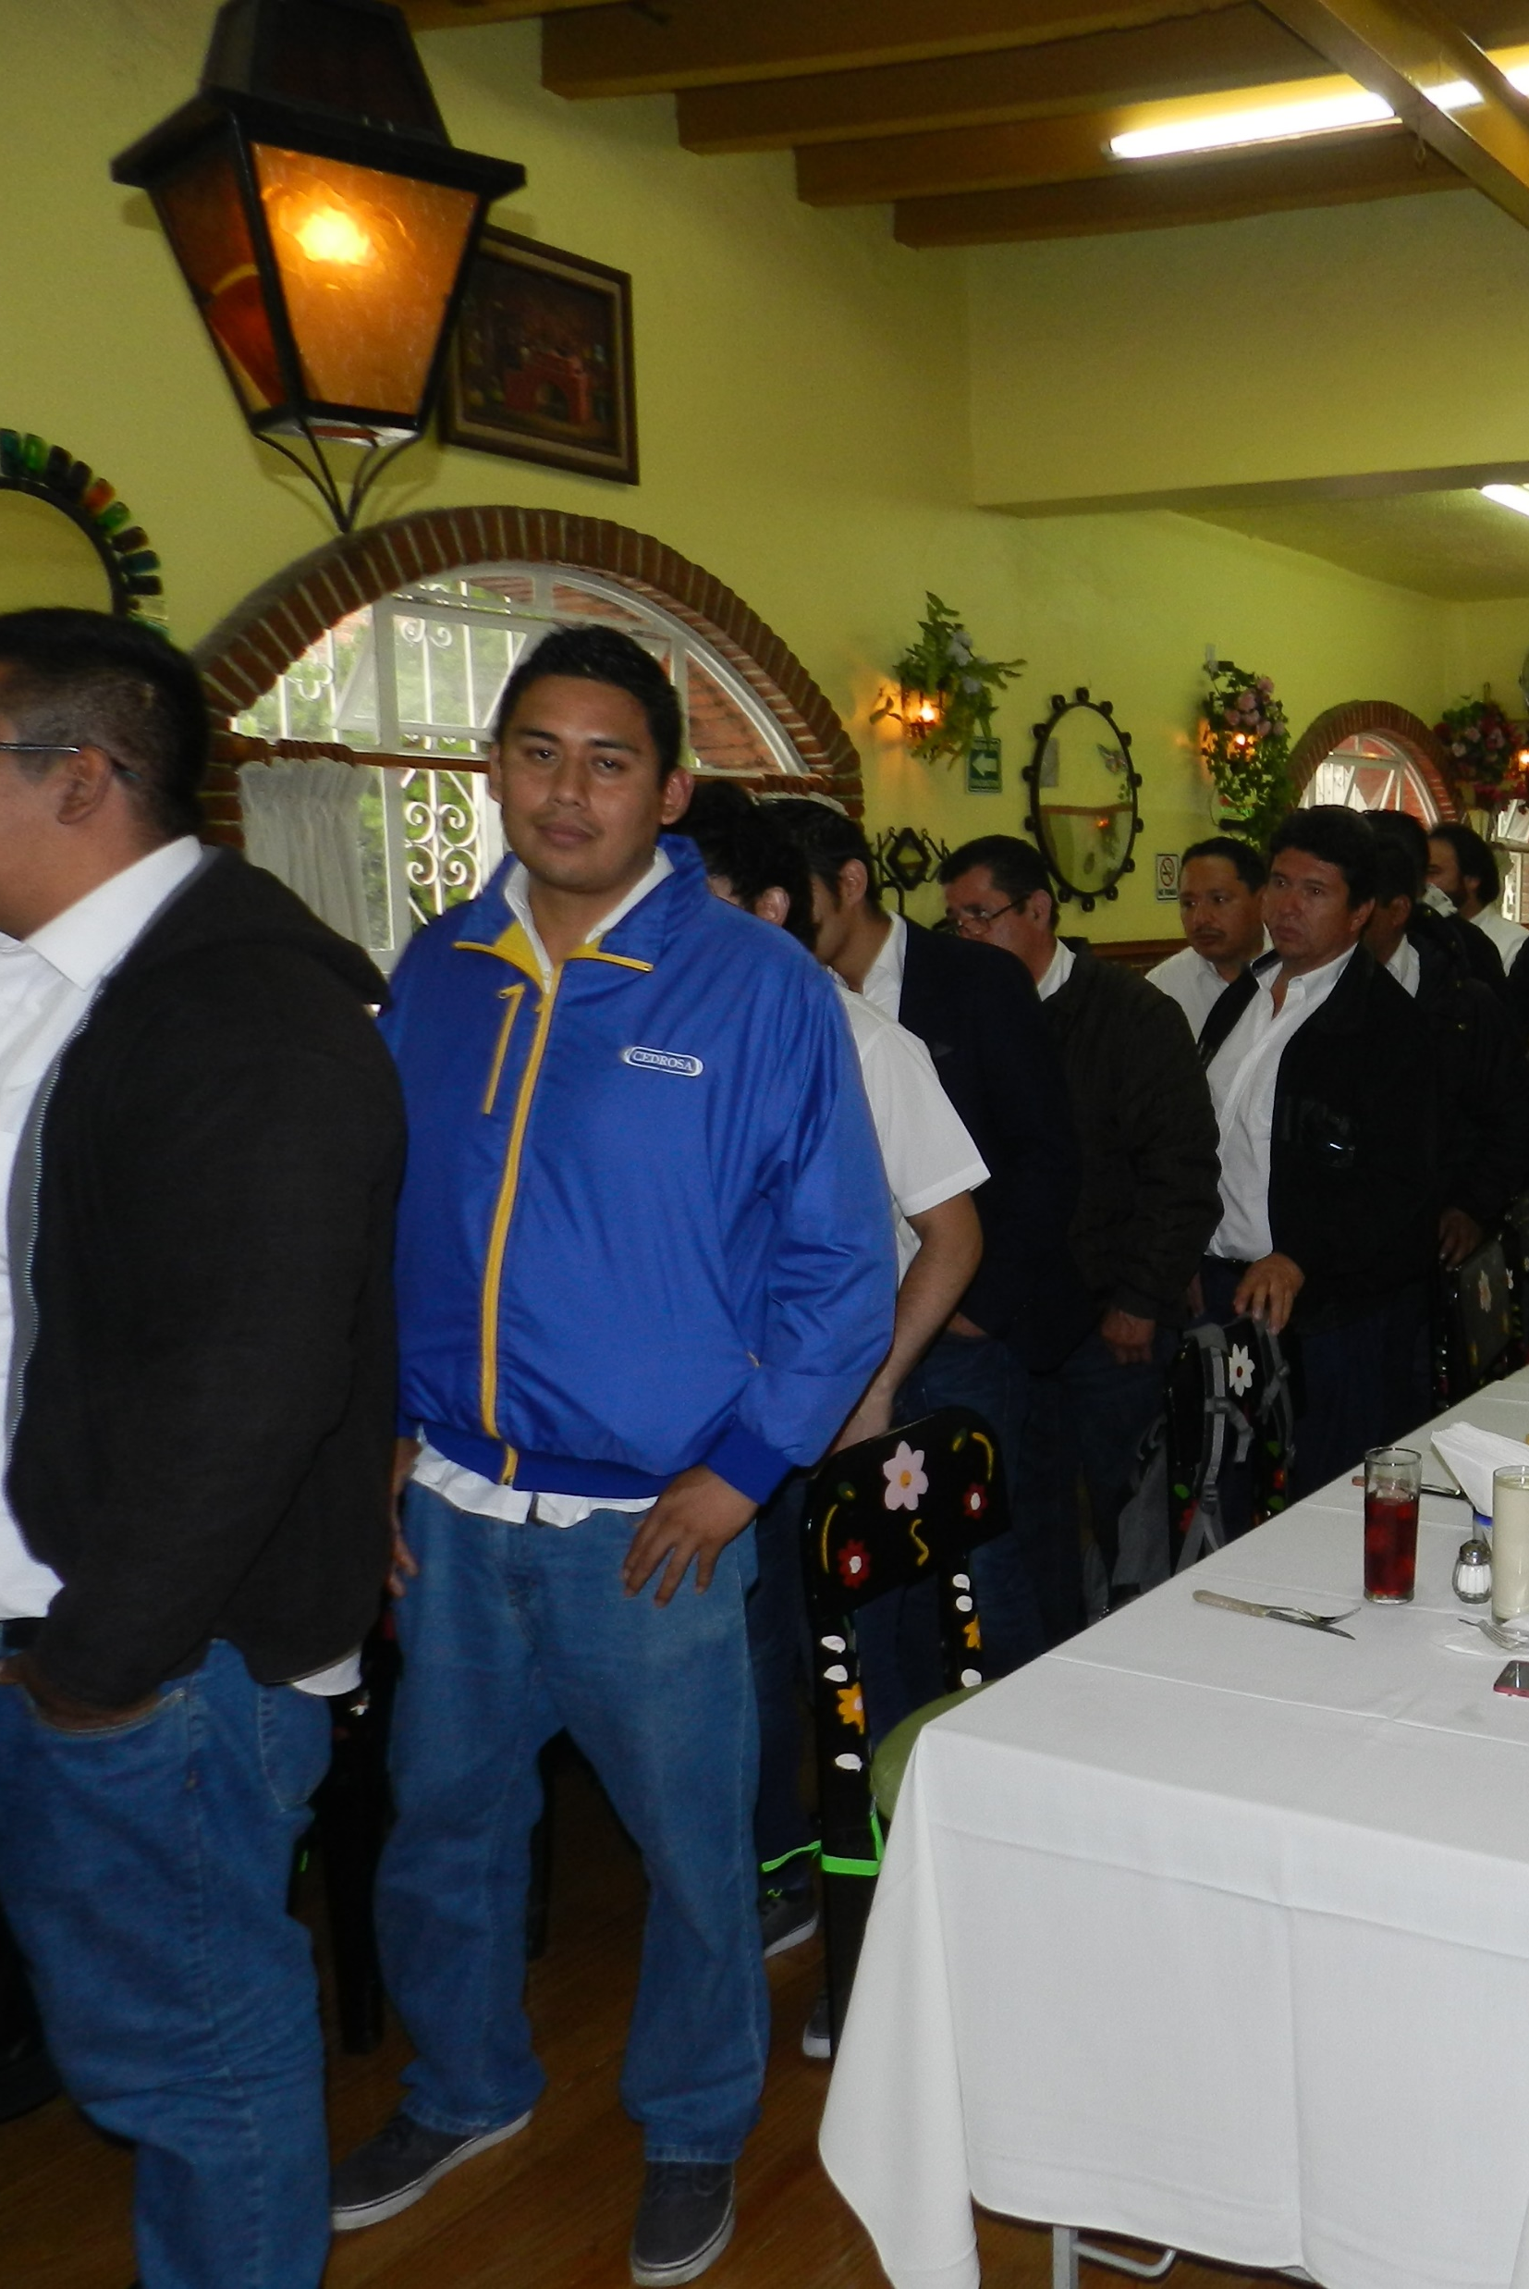
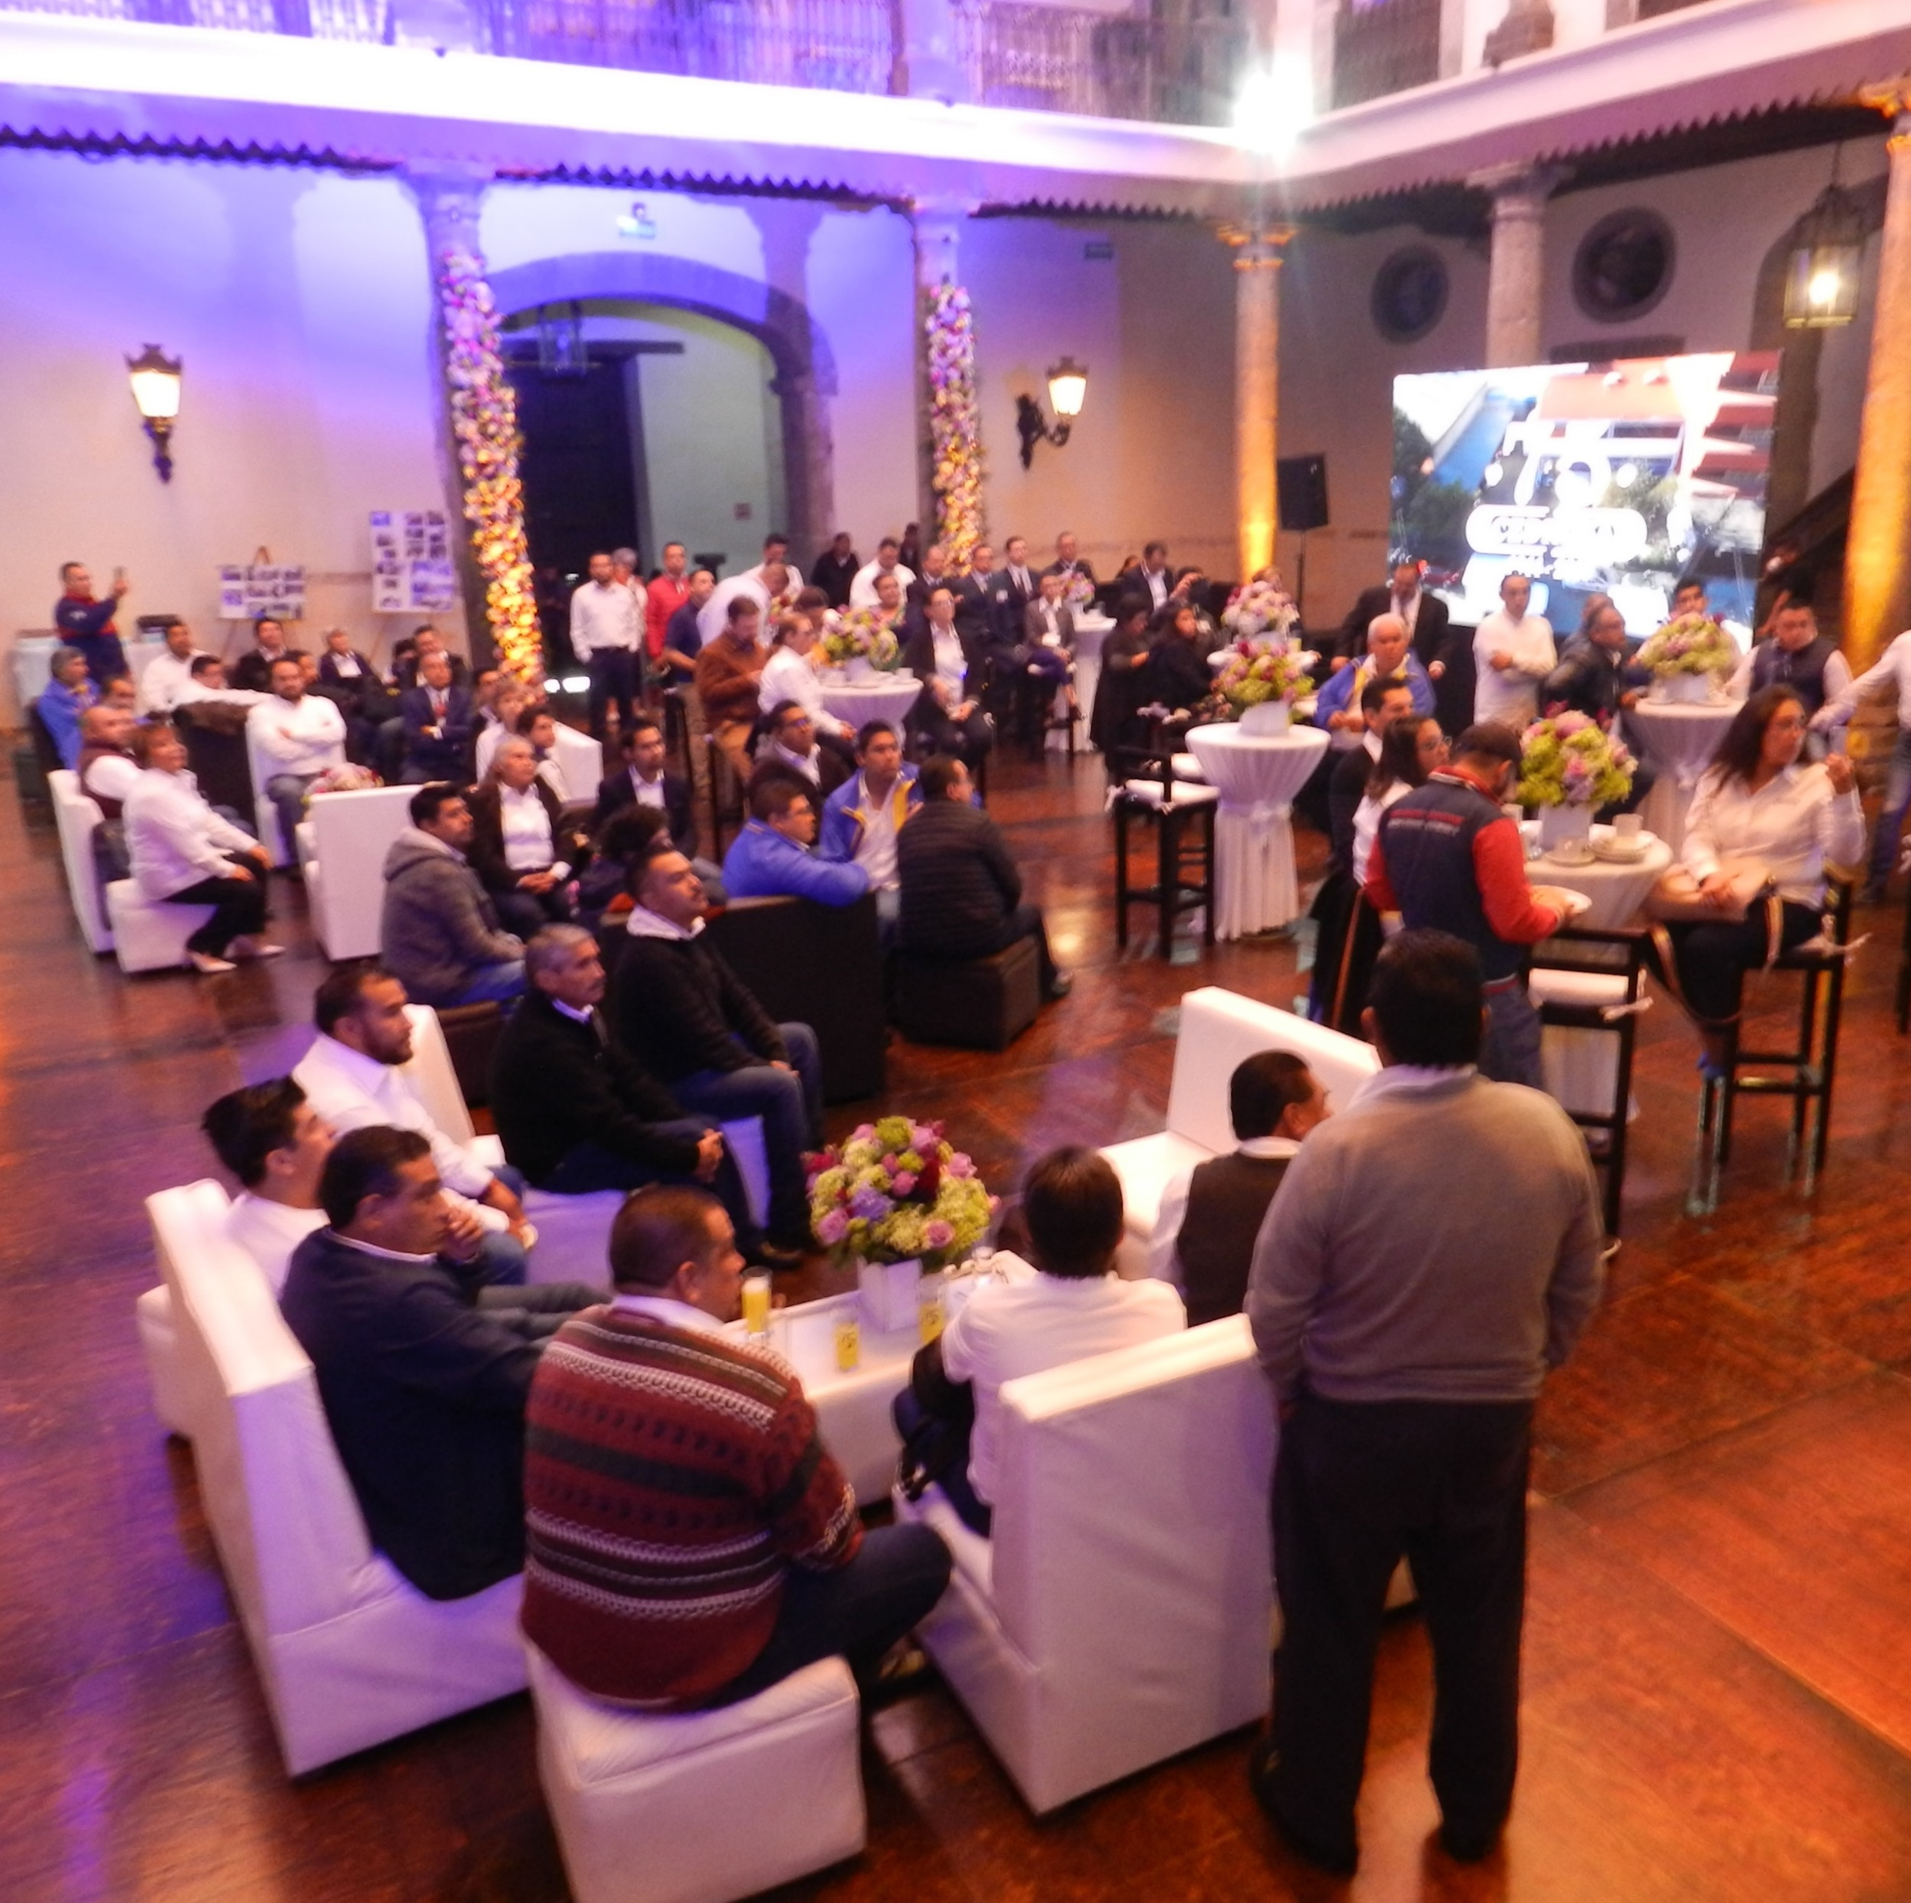

Slide 20

P.R. 75 Anniversary
31 Clients interested in Tricho concept-Trichotest
Interest in API´s “Repacked”
Formulations bulk for Pharmacies and wholesaler : gel, cream, lotions etc.
Clients interested in Academies & Lectures in formultion of cosmetic Products.

Slide 21

STRATEGIES
2020

Slide 22

Marketing Department Implementation

Slide 23


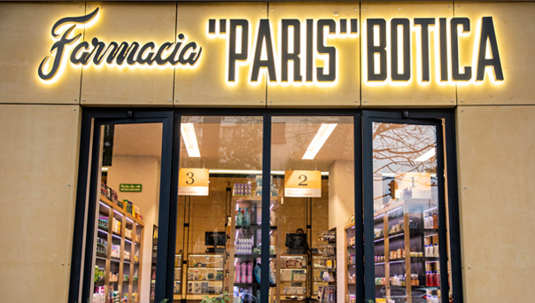

ACADEMIES Doctors & Pharmacies
(Budget 2020 = 15,000 / Month)

Slide 24


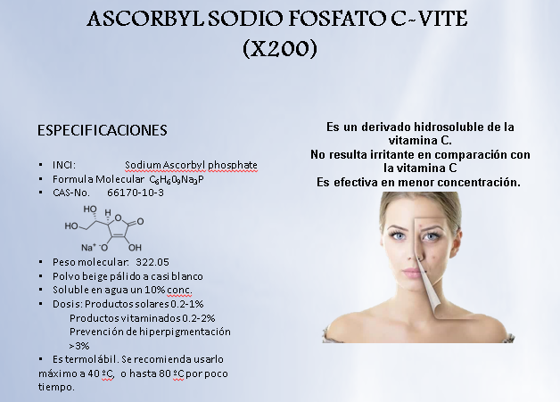

NEWSLETTERS

Slide 25


Implementation of a Blog, for doctors and pharmacies about personalized medicine.

Slide 26

SOCIAL
NETWORKS

Slide 27

JUNIO-AGOSTO 2018 |  | JUNIO-AGOSTO 2019
VISITS | 26 | VISITS | 115
LIKE | 3 | LIKE | 320
SCOPES | 9 | SCOPES | 25
INTERACTIONS | 3 | INTERACTIONS | 11
CONVERSATIONS | 47 | CONVERSATIONS | 136

Slide 28

GOOGLE MI NEGOCIO
JUNIO |  | AGOSTO 2019
SEARCHES | 24663 | ARRIVAL INSTRUCTIONS | 253
DISCOVERY | 20845 | CALLS | 41
BY BRAND | 262 | PHOTO VIEW | 3.83 K
VISITIS | 94.7 K
WEBSITE | 76

Slide 29

INSTAGRAM
JUNIO-AGOSTO 2019
FOLLOWERS | 123
AGE RANGE | 13-17 1% 18-24 11% 25-34 31% 35-44 24% 45-54 24% 55-64 7% 65+ 2%
Main cities | CDMX 26% Villa nic 5% Puebla 5% León 4% Naucalpan 3%

Slide 30


Slide 31

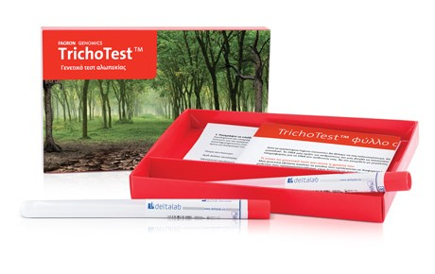
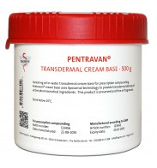

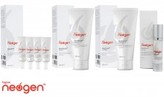
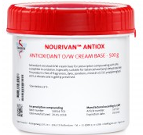
NASALAN
GESTRINONA
ACETATO DE DESMOPRESSINA
Testosterona Micro Fagron P344
ESTAGEL
NUTRIGEN

Slide 32







METABOLAID
DRENOW C
AHCC-SHIITAKE GOLD
MITIDOL

Slide 33





STOMAZINC
GLICOBERRY

Slide 34


NANO PEARL RESVERATROL
NANO PEARL CAVIAR
NANO PEARL VITAMINA C
NANO PEARL RETINOL
NANO PEARL GOLDEN BLUE
NANO PEARL ORIENTE
NANO PEARL SYMBIOCAPS
NANO PEARL CAFEINA

Slide 35





Slide 36





CONGRESOS
HAIR AND NAILS

Slide 37
BUDGET 2020
TRIMESTRE | EVENT | COST
JANUARY-MARCH
APRIL-JUNE
JULY-SEPTEMBER | Congreso internacional de pelo y uña DERMAJAL | 20,500.00 35,000.00
OCTOBER-DECEMBER | ANAFARMEX | 50,500.0
TOTAL= 106,000.00 MXN
5,579 USD

Slide 38

EQUIPE

Slide 39
TEAM / EQUIPE
2019
  Colaborators: 94
  Lay Off: 0
  Advanced Retirement: 0
  Retirement: 6
  Hired:3 (1 Tech.Marketing -1 Operations / 1 Doc.+Sales)
2018
  Colaborators: 100
  Lay Off: 3
  Advanced Retirement: 1
  Retirement: 3
  Hired :5
2020
Colaborators: 91
Lay Off: 0
Advanced Retirement :0
Retired : 4
Hired:1 (Marketing)

Slide 40

Corporate Culture / Team Building
  Training
    Values & Rules Implementation
PAYROLL
=> $40,106,566.00
=> $43,350,000.00
=> $42,336,296.28
SLIM DOWN 2%

Slide 41

CAPEX

Slide 42
IT UPGRADE (Hardware)
EQUIPO | CANT. | P.U. | SUBTOTAL | IVA 16% | TOTAL
Fortigate 3 años de soporte | 1 | 40,480 | 40,480 | 6,476.80 | 46,956.80
Aps AP-7632-680B30 | 1 | 16,740 | 16,740 | 2,678.4 | 19,418.4
CERTIFICACION RED | 1 | 45,000 | 45,000 | 7,200 | 52,200
CABLING INFRATRUCTURE NODOS | 20 | 2,840.40 | 56,808.0 | 9,089.28 | 65,897.28
DESKTOP | 13 | 13,250.0 | 172,250.0 | 27,560.0 | 199,810.0
MONITOR | 17 | 3,335.0 | 56,695.0 | 9,071.20 | 65,766.20
NOTEBOOK, +DOCK+KIT KEYBOARD/MOUSE | 4 | 23,490.0 | 93,960.0 | 15,033.6 | 108,993.6
MXN | 559,042.28
USD | 28,493.49032

Slide 43

UP GRADE
WEB PAGE
SOCIAL MEDIA
E-STORE

Slide 44
EQUIPMENT & WAREHOUSE
EQUIPMENT | COST
FORKLIFT UPGRADE | 38,000.00
FILLING LIQUID MACHINE | 35,000.00
Packing Adhesive Machine | 25,000.00
RACKS / Warehouse | 400,000.00
Air Plus Machine | 25,000.00
Filter System Air | 120,000.00
WEB PAGE & E-STORE | 25,000.00
TOTAL | 668,000.00

Slide 45

OWC

Slide 46
BUDGET 2020
OWC
2019L/E
2020 (Budget)
$170,916
40%
Stock : $123,023
Receivables: $71,568
Payables: $23,675
163,444
34%
Stock: $116,872
Receivables: $69,421
Payables: $22,849

Slide 47
BUDGET 2020
RECEIVABLES / PAYABLES
2019
2020
Receivables : Ratio 2.04=> 61.27 days
Receivables : Ratio 1.85=> 55.5 days
Payables : 37% Increase Avg/days (BUDGET: 36 days- Avg.)

Slide 48
INVENTORY DETAIL
 | 2019 | Budget 2020
POSSIBLE UNSELLABLE | $ 2,268,048.74 | $ 1,382,655.64
EXPIRED STOCK | $ 72,700.89 | $ 100,000.00
OVERSTOCK | $ 9,907,490.50 | $ 5,532,339.58
HEALTHY STOCK | $ 96,364,028.49
 | $ 108,612,268.62
RISK STOCK | $ 12,248,240.13 | $ 7,014,995.22
% Total Stock | 11.3%

Slide 49
CEDROSA |  |  |  |  |  |  | Budget 2020
Third Party Sales |  |  |  |  |  |  | 480,000
Sales |  |  |  |  |  |  | 480,000
Cogs |  |  |  |  |  |  | 336,000
Cost os goods sold |  |  |  |  |  |  | 336,000
Gross Margin |  |  |  |  |  |  | 144,000
Operational Margin |  |  |  |  |  |  | 144,000
Salaries &wages |  |  |  |  |  |  | 41,834
Bonus Provision (PTU) |  |  |  |  |  |  | 4,453
Dismissal Cost (Seniority Premium) |  |  |  |  |  |  | 502
Innovation |  |  |  |  |  |  | 312
Freight |  |  |  |  |  |  | 2,733
Faciities & Rental |  |  |  |  |  |  | 4,273
Contract third parties |  |  |  |  |  |  | 1,827
Traveling and hotel costs |  |  |  |  |  |  | 525
Others |  |  |  |  |  |  | 17,236
Opex |  |  |  |  |  |  | 73,695
Ebitda |  |  |  |  |  |  | 70,305
OM (sales third) |  |  |  |  |  |  | 30.0%
Opex (sales third) |  |  |  |  |  |  | 15.4%
Cost coverage ratio |  |  |  |  |  |  | 51.2%
Ebitda (sales third) |  |  |  |  |  |  | 14.6%
CAPEX |  |  |  |  |  |  | 1,228
FTE
OWC
 |  |  |  |  |  |  | Budget
Stock |  |  |  |  |  |  | 116,872
TR |  |  |  |  |  |  | 69,421
TP |  |  |  |  |  |  | 22,849
Operating working capital |  |  |  |  |  |  | 163,444
Operating working capital % |  |  |  |  |  |  | 34.1%

Slide 50

20/12
“FIESTA DE FIN
DE AÑO” Budget =>$100,000.00

